Slide 1
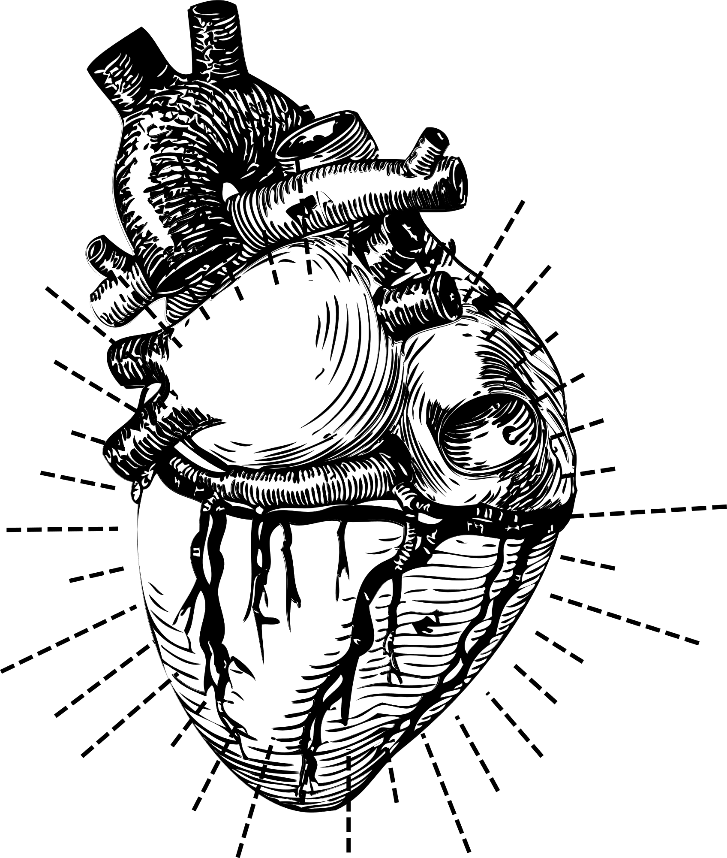
FINAL CAPSTONE
PREDICTION MODEL FOR HEART FAILURE
Presented by Kaytlin Wu

Slide 2
Aim of the Capstone
CARDIOVASCULAR DISEASE IS THE NUMBER 1 LEADING CAUSE OF DEATH WORLDWIDE
WORLD HEALTH ORGANIZATION
KAYTLIN WU | 2024

Slide 3



FACTS ABOUT CARDIOVASCULAR DISEASE
FROM THE KAGGLE HEART FAILURE DATASET
4/5 deaths from heart attacks and strokes.
1/3 deaths in individuals under 70
Heart Failure is a common event caused by Cardiovascular disease
KAYTLIN WU | 2024

Slide 4
HEART FAILURE KAGGLE DATASET
1190 Total Observations
11 Clinical Features
Age
Sex
Chest Pain Type
Resting BP
Cholesterol
6. Fasting Blood Sugar
7. Resting ECG
8. Max Heart Rate
9. Exercise Angina
10. Old Peak
11. ST Slope
KAYTLIN WU | 2024

Slide 5
Visualizations in Tableau
EXPLORATORY DATA ANALYSIS OF HEART FAILURE DATASET
KAYTLIN WU | 2024

Slide 6
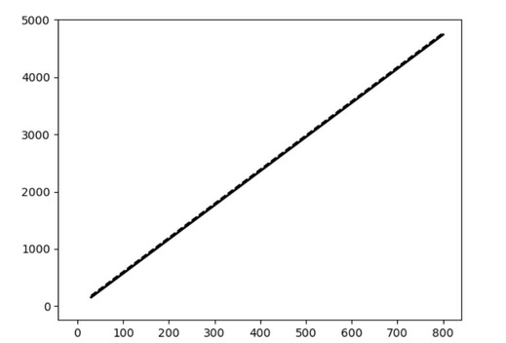
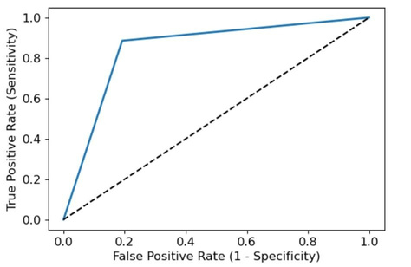
MODELLING
Generation of ML Models
Compared performance of SVM, Logistic Regression, and XGBoost Classifier
Hyperparameter tuning was performed
SVM
Logistic Regression
XGBoost
84.35%
Accuracy
85.71%
Precision
87.02%
Hyperplane
AUC ROC Curve
Recall
KAYTLIN WU | 2024

Slide 7
FINAL LOGISTIC REGRESSION MODEL EVALUATION
85.65%
Accuracy
86.65%
Precision
88.55%
Recall
KAYTLIN WU | 2024

Slide 8



FUTURE RECOMMENDATIONS
Expand Dataset Analysis
Additional ML Models
Feature Engineering
All ML model analyzed are limited by the total number of samples, so acquiring more data is critical to tuning the models.
Investigate whether there are more applicable models that are of better performance, including ensemble models.
Potential to leverage medical knowledge to connect parameters for more in-depth analysis.
KAYTLIN WU | 2024

Slide 9
Q&A
Acknowledgements
Kaggle Dataset: https://www.kaggle.com/datasets/fedesoriano/heart-failure-prediction/
GitHub Repository: ____________________
KAYTLIN WU | 2024

